Slide 1
Autonomous
Robot Platform
ECE298
Paul Rayes, Jose Villegas, Rochella Robinson

Slide 2

Overall Goal
to develop a platform that simplifies getting into robotics by supplying mobility and communications

Slide 3
Short-term Goals (partial list)
Reliable
Wireless communication
Detects and avoids obstacles
Creates a map of the environment
Knows where it is and where it is going
Goes to a point specified by the user
Automatic Battery charging

Slide 4
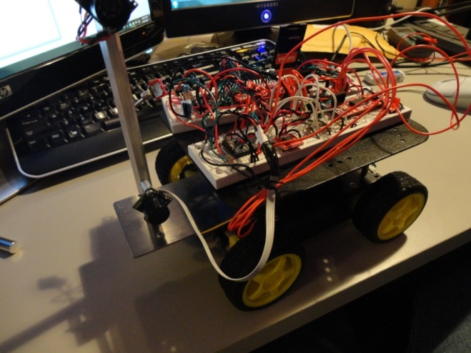
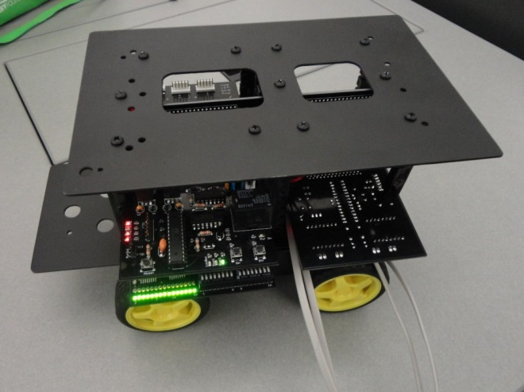

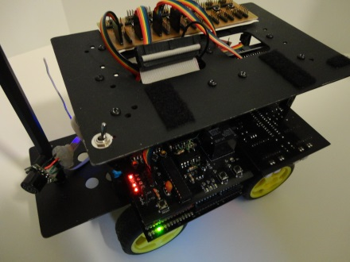
Previous Semesters
Spring 2012
Fall 2012
Spring 2013
First prototype on breadboards
Basic obstacle avoidance
Custom circuit boards
Partially custom structure
Mostly custom structure
Lots of planning
Basic obstacle avoidance again
Wireless

Slide 5

This Semester
Bump sensors
Improved maneuverability
  2-wheel drive
  Lighter structure
  Omni wheels
Wireless video
Sends wireless data to C++ base program
  Nearby obstacles
  Direction robot is facing
I think I’m lost…

Slide 6
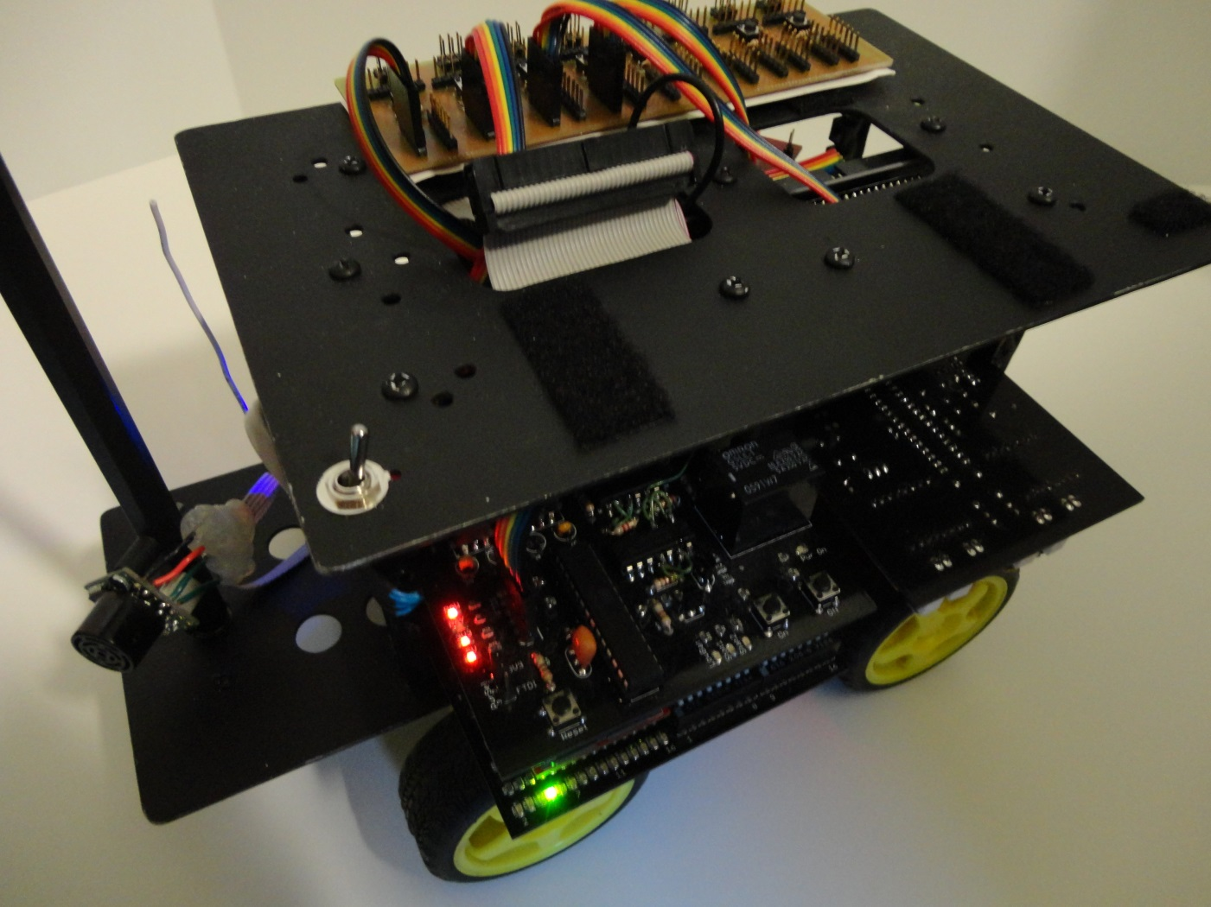
This Semester
Robot as of right now
Has obstacle avoidance again and wireless

Slide 7
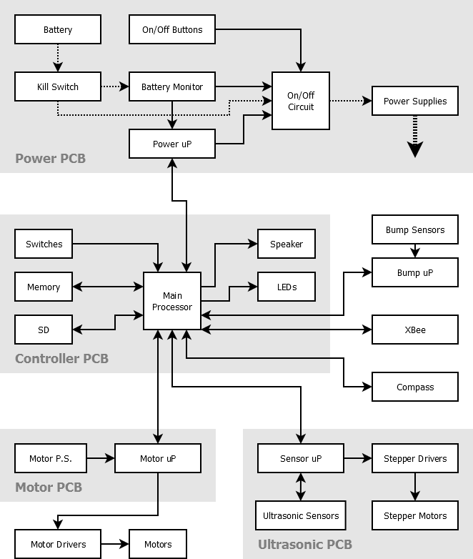

Slide 8


Next Steps
Dead reckoning
  Where robot is, what direction it is facing, where it is going
Map creation
Navigation
Multiple ultrasonic sensors
  Improved speed
Simplified 1- or 2-board design
  Cheaper, faster to build, easier to use
  Less flexibility, slightly harder to upgrade
Faster microprocessor

Slide 9
Next Step: Map
Create map with x,y positions
  “Explore Mode”: Robot explores, creating a map
Send map to base and display on screen
Able to click on point and robot will go there
Able to find itself after being power cycled and/or moved
Beacons at known positions
  one required, more will improve accuracy

Slide 10
Failures / Lessons Learned
Dead reckoning is very, very hard
Don’t overcomplicate things
Seeing what is happening is important
  e.x., DMM, oscilloscope, logic analyzer
  Add more test points
Document

Slide 11
Questions

